Slide 1
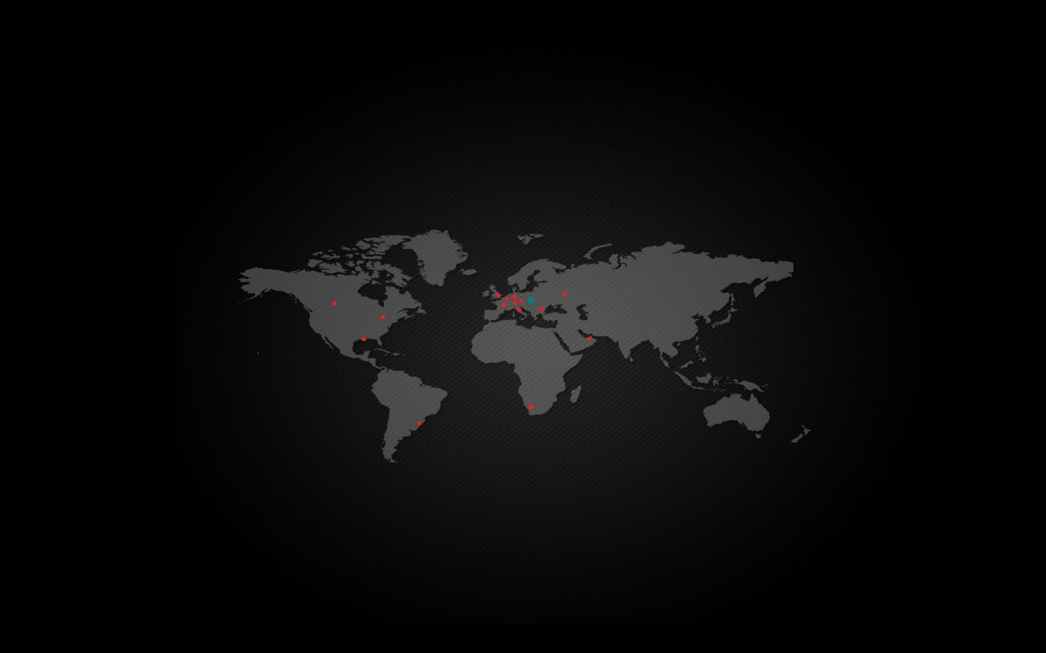


FIMAD, s.r.o.
You know what.... We know how!!!

Slide 2
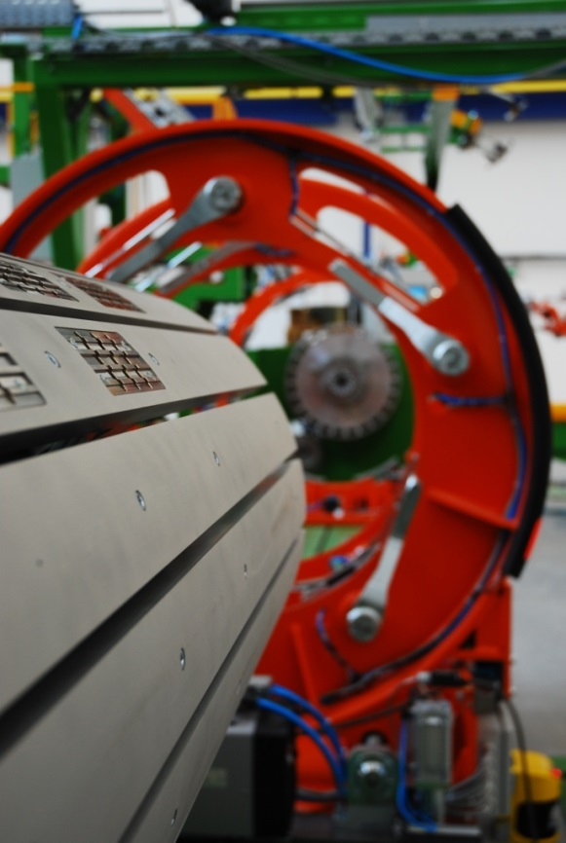

Contents
Company Introduction
Machine Park
  CNC Milling Centers
  CNC Turning Centers
  Grinding Machines
  Electric Discharge Machining
  Quality Department
  Heat treatment & Cutting
Products
References

Slide 3
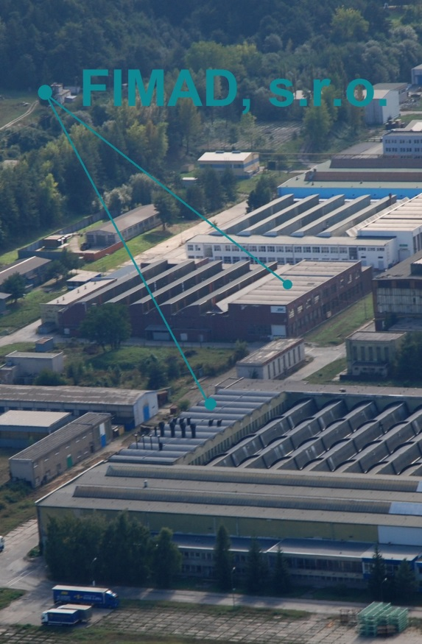
FIMAD company is specialized in production and business in engineering field since 1997 as a family plant.
From the very beginning we gradually worked up from manufacturer of easy spare-parts to the supplier of the high-quality parts which are used in automotive, energetic, railway, oil & gas, pulp & paper, woodworking, rubber and Injection molding industry.
Nowadays we provide our customers full-service including construction, technology, securing of semi-products, production, testing, final inspection and deliveries of functional parts.
FIMAD company is settled in own premises (14700 m2).

Slide 4
FIMAD
Automotive
Assembly
Rubber
Energetic
Railway
Pulp & Paper
Injection molding
Oil & Gas

Slide 5
Sales Turnover
2008 | 2009 | 2010 | 2011 | 2012 | 2013 | 2014 (Forecast)
3227843 | 1846956 | 2406772 | 4032141 | 4670183 | 5192435 | 5500000

Slide 6
84 Employees IN TOTAL
28 white collars
53 blue collars

Slide 7
Board of Directors
Head of Purchasing Department
Purchasing
Logistics
Head of Quality Department
Quality
Head of Commercial Department
Head of Technology Department
Head of Production Department
Sales
Maintainance
Head of Accounting Department
Invoicing
Marketing
HR
TLG
CNC machining
Conventional machining
Assembly
Electrical discharge machining
Certification

Slide 8
Safety
Safety of our employments and visitors first.
During factory walk:
Stay in one group always between designated yellow lines
Pay attention on the forklifts
Wear safety glasses and hearing protection is obligatory
Emergency procedure: after emergency ring follow the instruction of leader of group

Slide 9
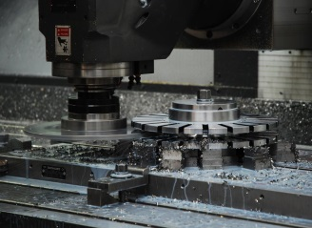
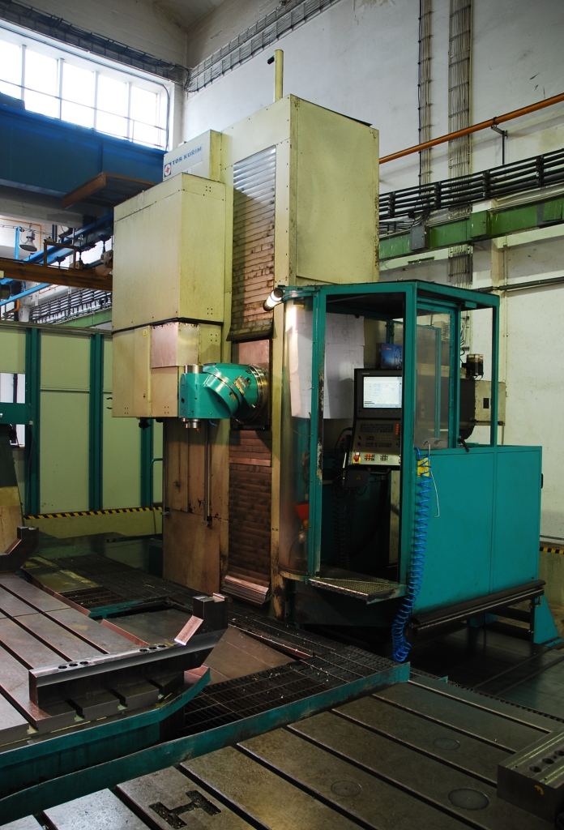
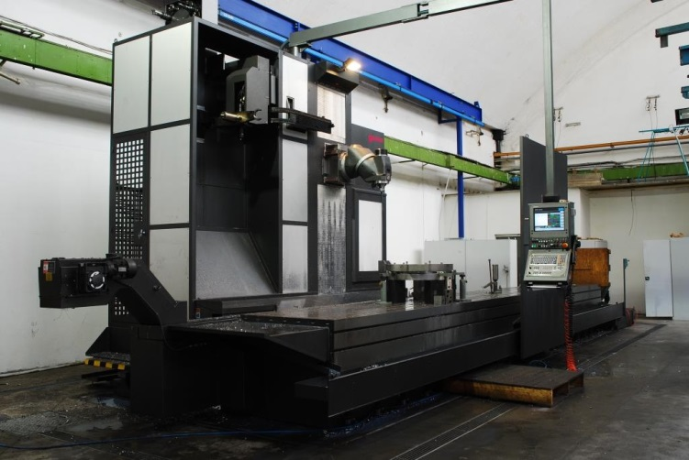
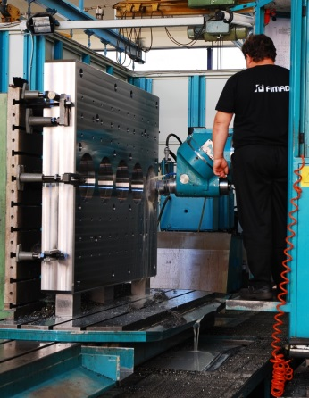
Heavy duty CNC Milling Machines
 | Working range | Working range / movable table | Controlled axes
FUQ 150 | 8000 x 3000 x 2500 mm | 3000 x 2000 x 2500 | 5
Lagun | 9000 x 1100 x 2000 mm |  | 5

Slide 10
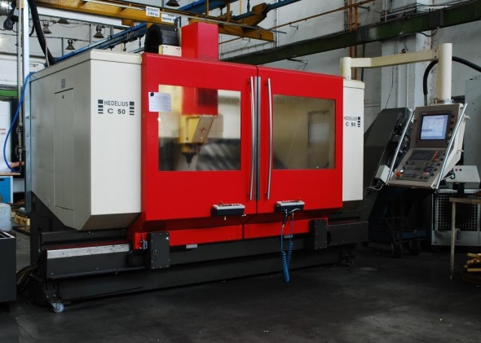
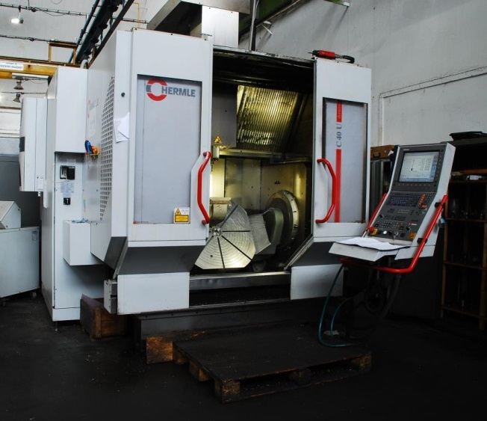
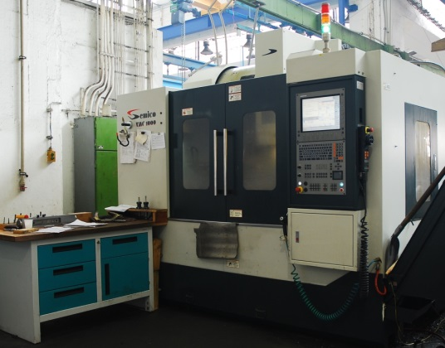
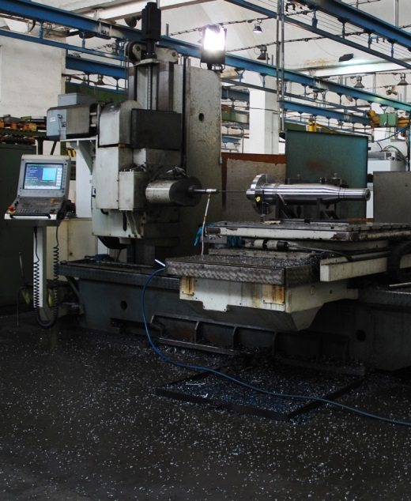
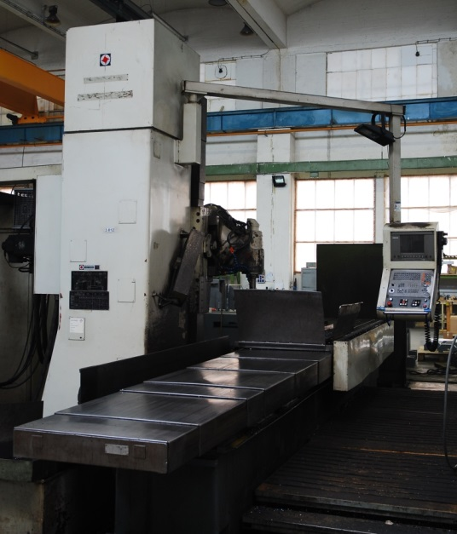
CNC Milling Machines
 | Max. working range | Controlled axes
Hermle C40 | 850 x 700 x 500 mm | 5
Hedelius C50 | 1800 x 510 x 480 mm | 4
Semico | 1050 x 550 x 608 mm | 3
Semico | 1050 x 550 x 608 mm | 3
WF 100 | 1230 x 905 x 2000 mm | 4
FSQ 80 CNC | 3000 x 880 x 940 | 3

Slide 11
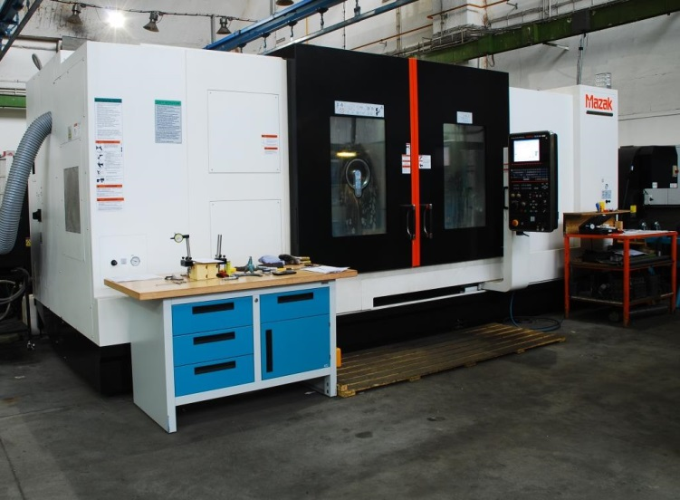
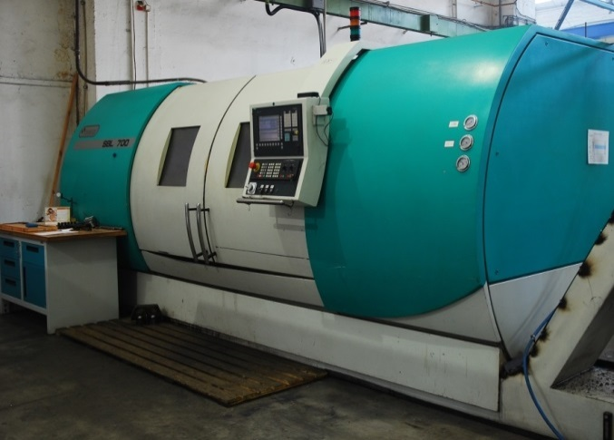
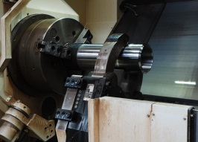
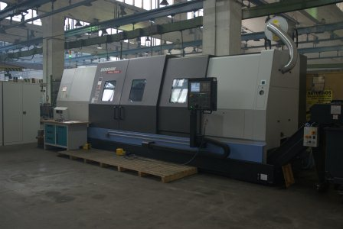
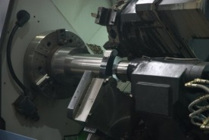
Heavy duty CNC Turning Centers
 | Max. Working range | Automatic steady rest | Controlled axes
Mazak | Ø 910 x L2000 mm | Ø 100 - 410 mm | X, Z, C
Puma | Ø 1000 x L3000 mm | Ø 100 – 350 mm | X, Z, C
SBL700 CNC | Ø 750 x L2000 mm | NO | X, Z, C

Slide 12
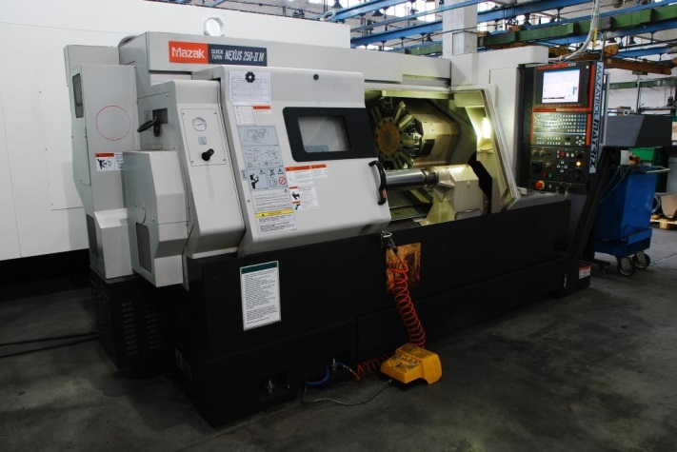
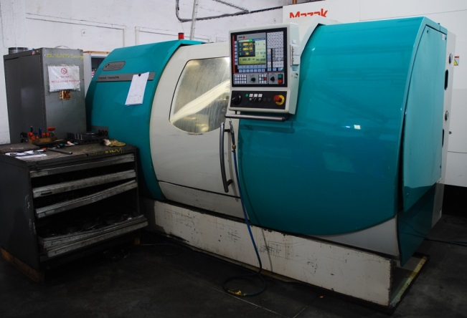
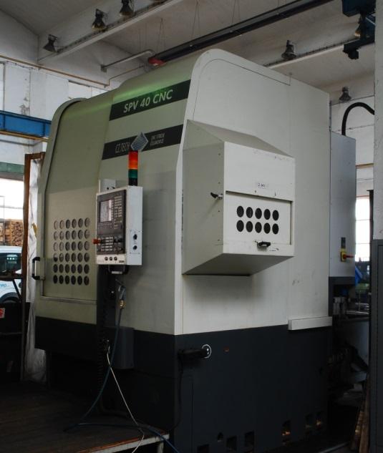
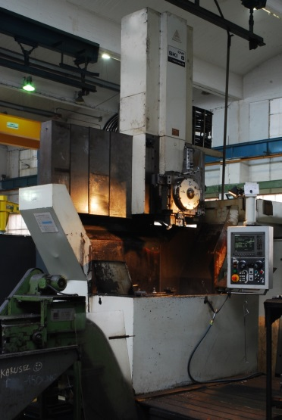
CNC Turning Centers
 | Working range
MAZAK Nexus 250-II M | 380 X 1085 mm
SBL500 CNC | 630 x 750 mm
SBL500 CNC | 630 x 750 mm
CNC Vertical Lathes
 | Working range
SPV 40 CNC | 850 x 800 mm
SKI 8 CNC | 1100 x 795 mm

Slide 13
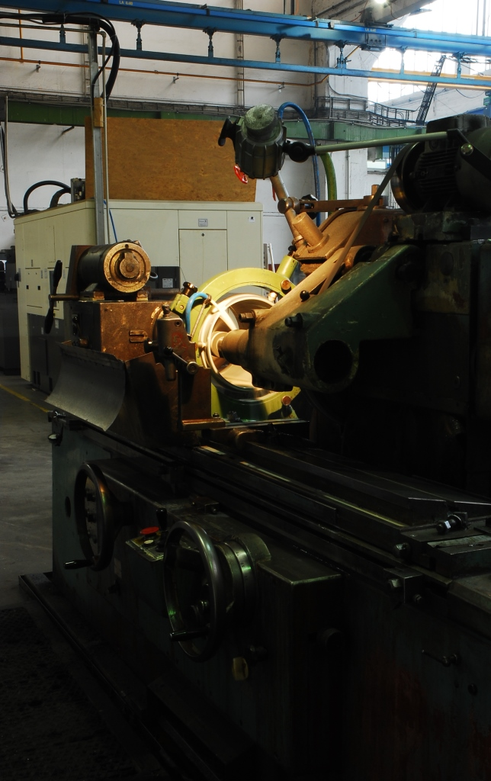
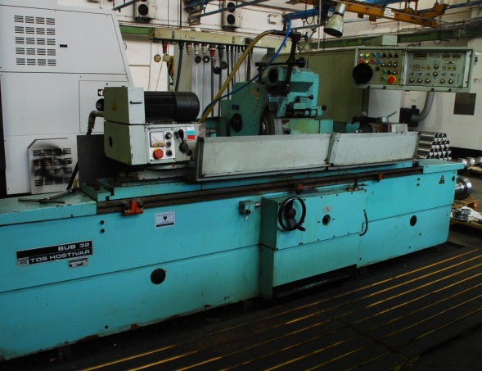
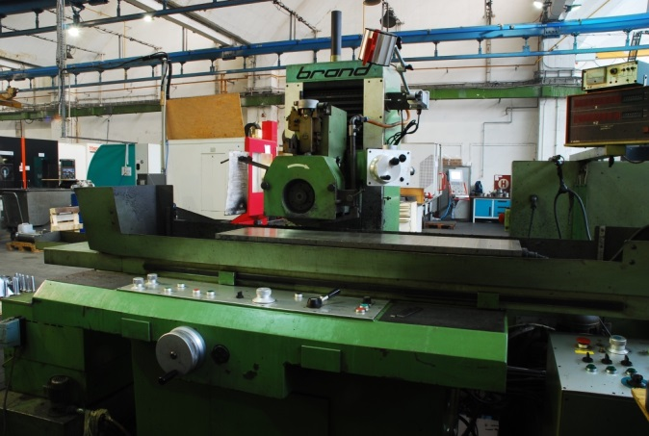
Grinding Machines
 | Travel
BHU 50 A | 500 x 1000 mm
BRH 40 | 400 x 1000 mm

Slide 14
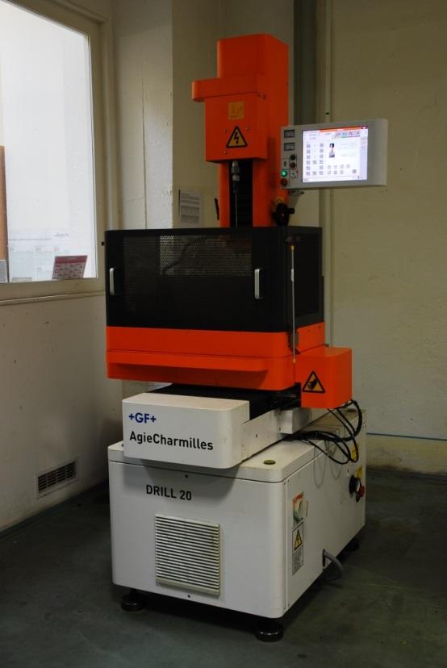
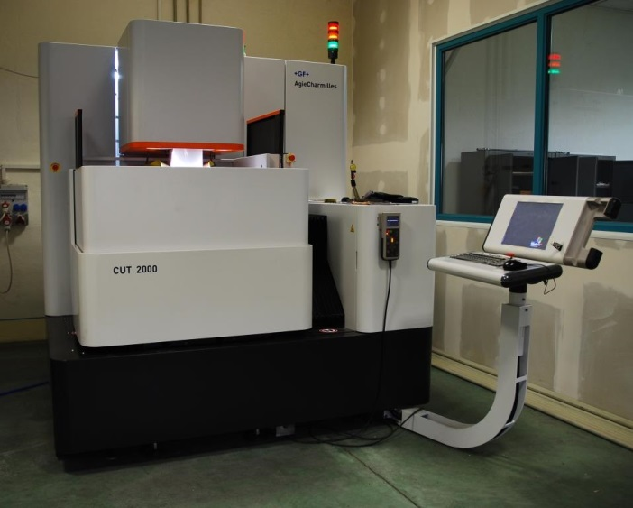
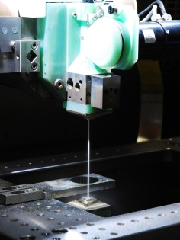
Agie Charmille CUT 2000
X, Y, Z travel | 350 x 250 x 256 | mm
U, V travel | ± 70 | mm
Max taper angle | 30 / 100 | °/mm
X, Y, axes speed | 3 | m/min
Dual measuring system for X, Y | Štandard | -
Workpiece Dimensions (W x D x H) | 750 x 550 x 250 | mm
Max. workpiece weight | 200 | kg
Surface finish | 0.05 | μm Ra
Agie Charmille Drill 20
Electrode diameter | 0.15 up to 3 | mm
Maximum drilling depth | 200 | mm
Maximum workpiece weight | 300 | kg
Travel paths of axes X, Y and Z | 300 x 200 x 300 | mm
Work table size, length x width: | 400 x 300 | mm

Slide 15
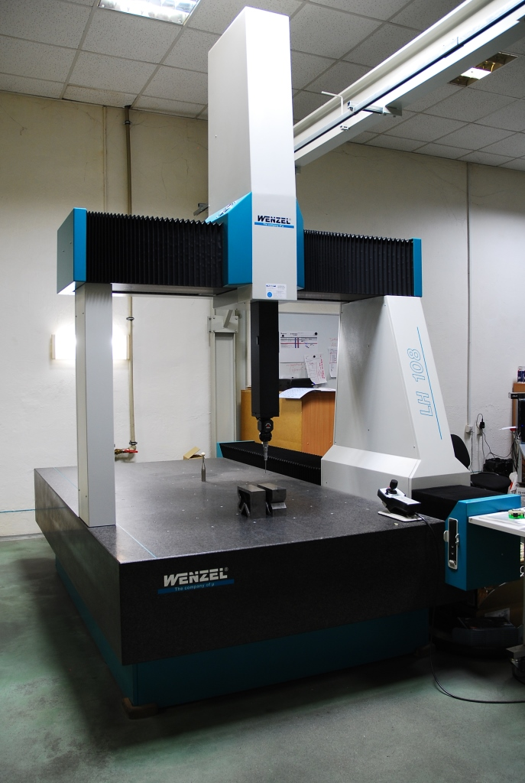
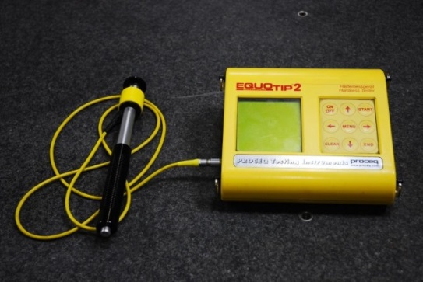
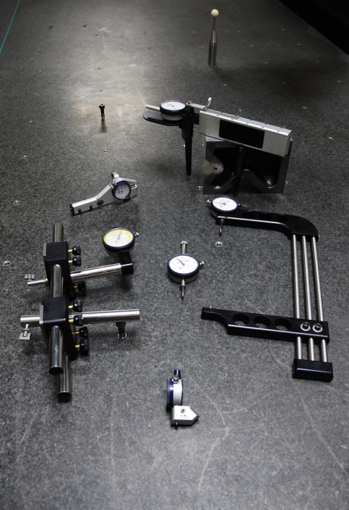
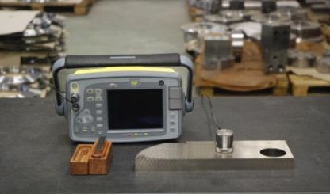
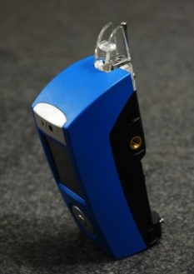
Quality Department
WENZEL LH 108 | 1600 x 1000 x 800 mm
EQUOTIP 2
SITESCAN 250
GAGEMAKER SET | Measuring equipment for threading
SONATEST 250 S

Slide 16
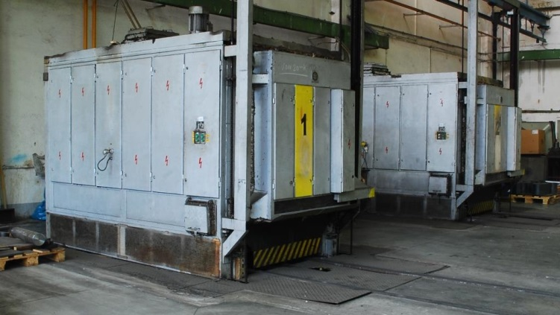
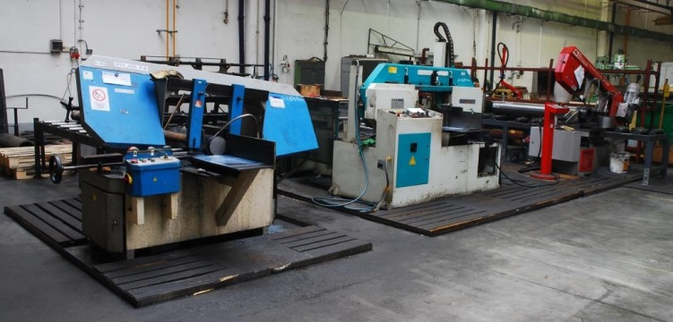
Car Bottom Furnace´s
 | Travel
CAN 10.2,5 | 1000 x 1000 x 2500 mm
CAN 10.2,5 | 1000 x 1000 x 2500 mm
SAW´s
 | Max. Ø of Material
PTX 405 P-A | 360 mm
PTX 326 | 320 mm
BOMAR | 350 mm

Slide 17
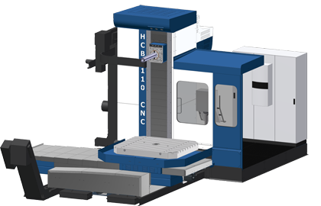
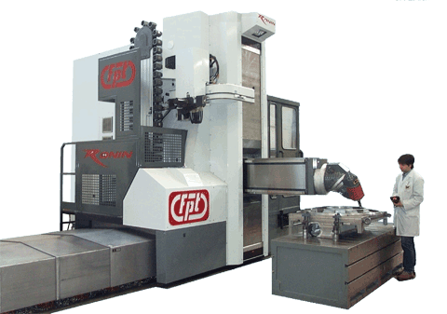
COMING SOON:
FPT RONIN
Maximum work-piece weight | 30 000 | kg
Travel paths of axes X, Y and Z | 6 000 x 1 500 x 3 000 | mm
Rotary table size, length x width | 2 000 x 3 000 | mm
HCB 110 CNC
Maximum work-piece weight | 8 000 | kg
Travel paths of axes X, Y, Z and W | 2 000 x 1 600 x 1 400 x 650 | mm
Rotary table size, length x width: | 1 400 x 1 600 | mm

Slide 18
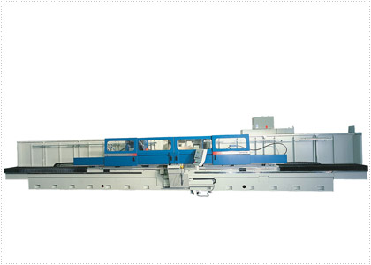
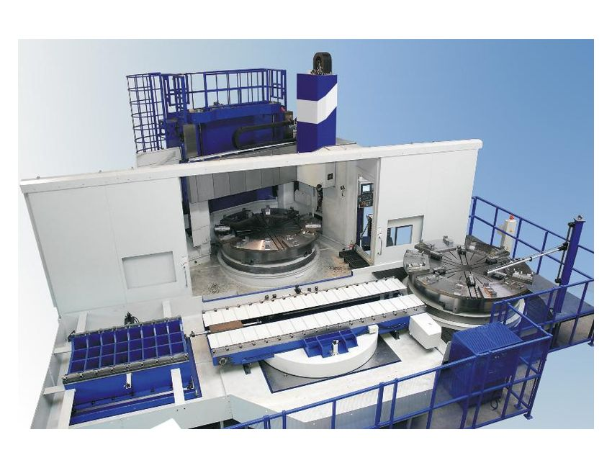
VLC 2500 ATC+C-III
Work table diameter | Ø3 000 | mm
Max . Swing | Ø3 400 | mm
Max . turning diameter | Ø3 300 | mm
Max . turning height | 3 000 | mm
Max . Work-piece weight | 20 000 | Kg
BUC 80
Swing Ø | 800 | mm
Centre-to-centre distance max. | 5000 | mm
Weight of clamped work-piece:
In centres max. | 3 000 | kg
In open rests * | 4 000 | kg
Flying, incl. clamp, max. * | 300 | kg
Maximal weight of work-piece with heavy drive headstock: *
In centres | 4 000 | kg
Flying, incl. clamp | 400 | kg

Slide 19
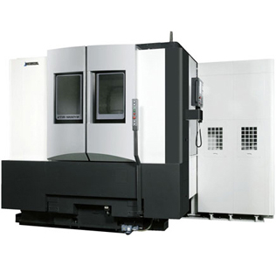
VTM-1200YB
Controlled axes | 5
Max. chuck size | Ø1 250 | mm
Max. machining diameter | Ø1 200 | mm
Max. swing diameter | Ø1 500 | mm
Max. turning length (height) | 1 080 | mm
Max. work-piece load | 3,000 [5,000] [with chuck] (6,600) | kg

Slide 20
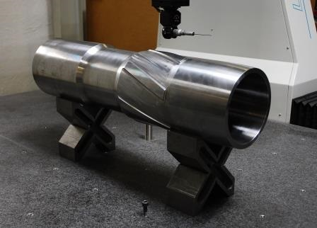
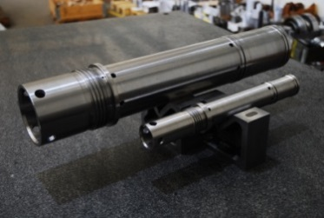
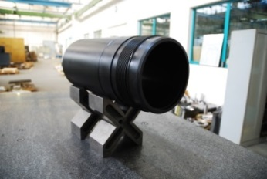
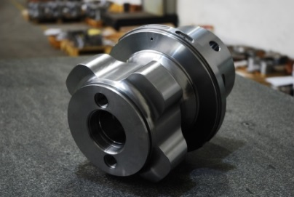
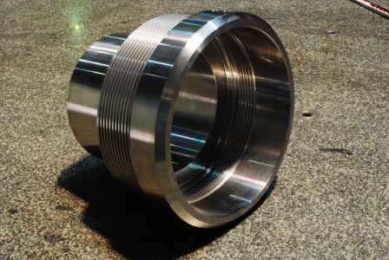
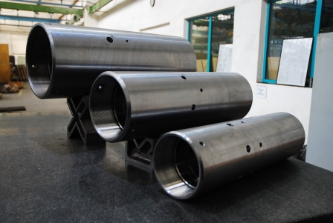
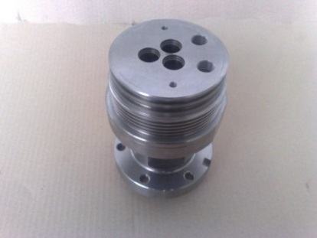
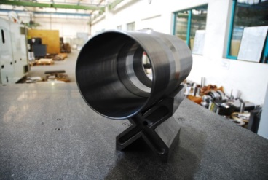
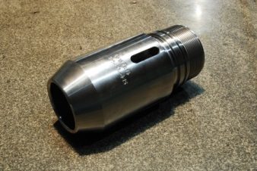
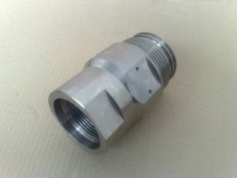
Oil & Gas Industries

Slide 21
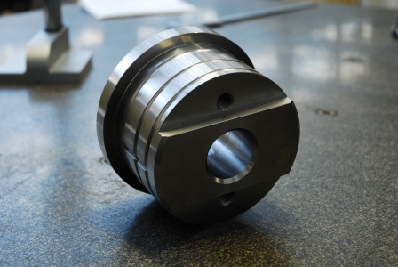








Automotive

Slide 22





Railway Industries

Slide 23











Energetic Industries & Others

Slide 24






Assembly

Slide 25









References

